Slide 1
Medical Reserve Corps COVID-19 Rapid Response Saliva Testing Team
Kathy Berlin U of M Medical Reserve Corps Coordinator
October 7, 2020

Slide 2
Agenda
Purpose
Team Expectations
Roles
Health & Safety/ PPE
Deployment Process
Scheduling & Shifts
Contacting HERO staff
Q&A

Slide 3
Campus COVID-19 Testing
Mtest
Saliva Testing Program
Rapid Response Saliva Testing

Slide 4
Purpose
This team will conduct COVID-19 Saliva Testing for the University of Minnesota, in the event of:
Newly identified cluster of cases
An outbreak of cases related to an identifiable group and/or location on campus

Slide 5
Team Expectations
Complete mandatory online HIPAA training (Link to HIPAA Training)
Complete mandatory, 30-minute online training session on saliva testing Completed
Review MRC handbook and addendum
Available to be deployed on short notice
Notes:
HIPAA Training- For those of you who recently completed a HIPAA training and have run into an error upon completion. Please send us an email and we will send you information on who to contact to resolve that issue.
24-72 hours

Slide 6
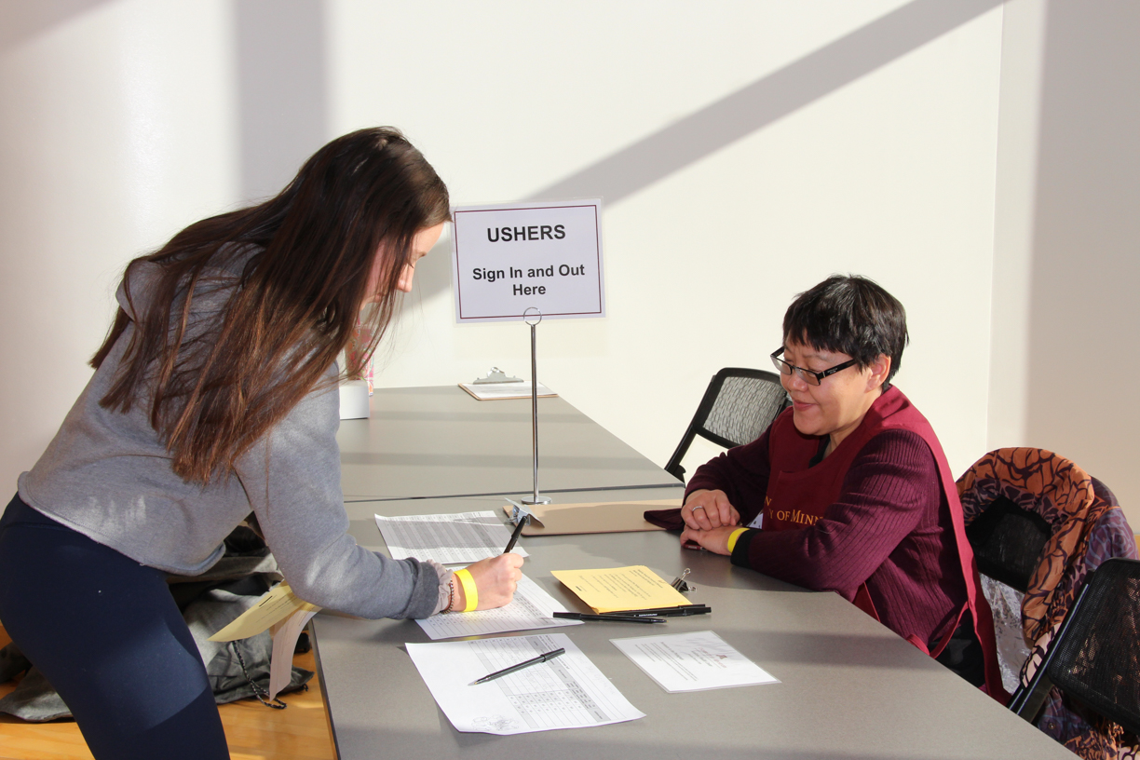
Roles
Registration Clerk
Saliva Test Observer
Logistics Support
Team Lead-Health Emergency Response Office Staff
Notes:
Registration Clerk: Welcome and register individuals to be tested- (Check ID, mark them on roster)
Saliva Test Observer: Instruct individuals on saliva test process and observe proper collection of saliva sample
Logistics Support Staff: Responsible for site set up and supplies
Team Lead: Health Emergency Response Office staff

Slide 7
Rapid Response Saliva Testing Team Position Checklist: Registration Clerk
Welcome individuals
Check ID
Verify no drinking, eating, smoking, chewing gum for 30 minutes
If “no”, direct to testing station
If “yes”, instruct to wait amount of time needed to equal 30 minutes of no drinking, eating, smoking, chewing gum
Place check next to name on roster
Direct to testing station

Slide 8
Rapid Response Saliva Testing Team Position Checklist: Logistics Support
Set up registration area and testing stations
Measure 6-8 feet between testing station tables
Measure and mark queuing area (6 feet)
Wipe testing tables with disinfectant in between tests
Place test kits on tables in between tests
Restock supplies, as needed
Take down testing stations at end of session

Slide 9
Rapid Response Saliva Testing Team Position Checklist: Observer
Instruct individuals on saliva test process
Observe proper collection of saliva sample
Verify completed tests (saliva test tube in plastic bag) are placed in appropriate collection bag
Direct individuals to throw away used test kit tray items

Slide 10
Health & Safety
“Go” Bags for each team member with supplies
Surgical masks, gloves and goggles will be provided
Remember to disinfectant gloves when you come into contact with samples or other contaminated materials
Disinfect goggles at end of shift and place in Go bag
Notes:
Each team member will be provided a “go” bag which will includes, a surgical mask, gloves and goggles
Do we want to remind them not to sign up for a shift if they have symptoms, i.e. Do not sign up for a shift if you have symptoms or have been exposed to COVID (Or remind them to read Handbook Addendum to follow safe COVID deployment protocols).

Slide 11
Deployment Process
Boynton notifies HERO staff of cluster/outbreak
Team members are notified (email, text, phone call)
Team members sign up for shift
Meet at testing site
Deployed as a team of at least 3
Notes:
Ask that everyone sign in when arrive
Onsite set up and just in time training will happen before shift begins
Parking vouchers will be provided (depending on the site location)

Slide 12
Shifts
8 am - 7 pm; potentially 7 days a week
Anticipated length of shifts will range from 2 to 4 hours
Sign up for a shift using Shiftboard
Notify Team Lead if ill or cannot make shift
Notes:
You will not be required to respond to every deployment opportunity. Everyone on the team will be contacted when a need arises and you will have an opportunity to sign up on Shiftboard if you are available to fill that role for that date and time.

Slide 13
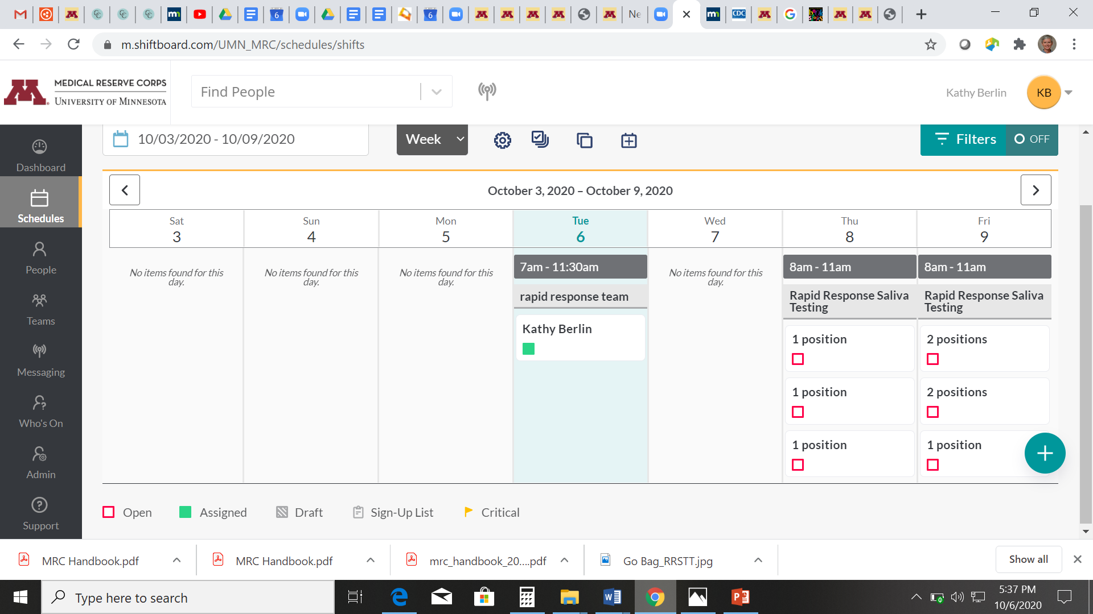
Scheduling: Shiftboard
Shiftboard
Click on “Schedules”
Find date of deployment
Click on “available” for role you wish to fill
Reminder email
Notes:
DEMONSTRATE

Slide 14
Show and Tell
https://youtu.be/HDdSLAps04Y
Test Kit

Slide 15
Final Thoughts
If sick…..
Parking
Adaptable and flexible

Slide 16
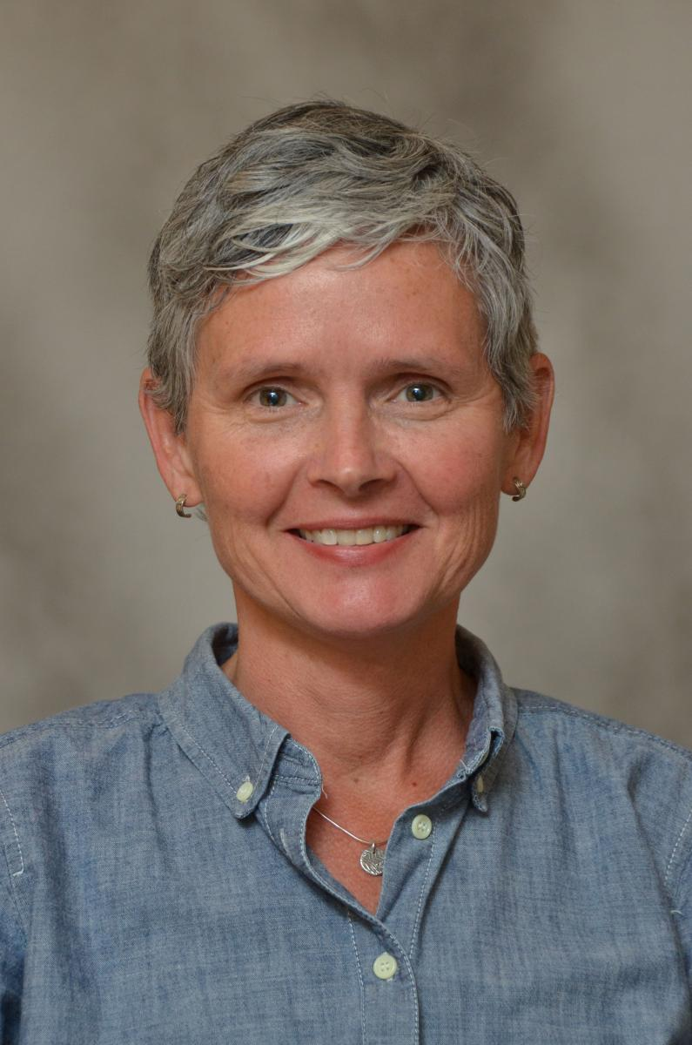
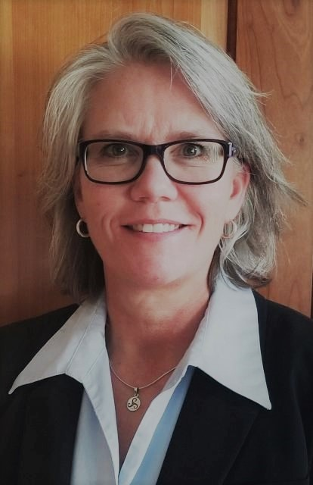
How to Contact HERO Staff
Email us at medicalreserve@umn.edu
Megan Whittet
Kathy Berlin 612-202-0715
Kris Kaus

Slide 17
Q&A

